Slide 1
Computer vision
-Vivek

Slide 2
Definition
From the perspective of engineering, it seeks to automate tasks that the human visual system can do. Computer vision tasks include methods for acquiring, processing, analyzing and understanding digital images.

Slide 3
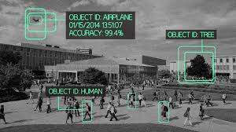

Slide 4
History
1960:-computer vision began at universities that were pioneering artificial intelligence, a stepping stone to endowing robots with intelligent behavior
1966:-it was believed that this could be achieved through a summer project, by attaching a camera to a computer

Slide 5
1970:- extraction of edges from images, labeling of lines, non-polyhedral and polyhedral modeling, representation of objects as interconnections of smaller structures, optical flow, and motion estimation
1980:-studies based on more rigorous mathematical analysis and quantitative aspects of computer vision.
1990:- some of the previous research topics became more active than the others.

Slide 6
Related Fields
Pattern recognition
Solid state physics
Neurobiology
Signal Processing
Image Processing

Slide 7
Applications:-
Automatic inspection, e.g., in manufacturing applications
Assisting humans in identification tasks, e.g., a species identification system
Controlling processes, e.g., an industrial robot
Detecting events, e.g., for visual surveillance or people counting
Interaction, e.g., as the input to a device for computer-human interaction
Modeling objects or environments, e.g., medical image analysis or topographical modeling
Navigation, e.g., by an autonomous vehicle or mobile robot; and
Organizing information, e.g., for indexing databases of images and image sequences.

Slide 8
Navigation:-
“At present, the programme have been created that is designed to allow a computer to keep a car within a lane on a highway, because nowdays people plan to use the programme to drive a car” .
This programme, which uses algorithms to sort visual data and make decisions related to finding the lanes of a road, detect how those lanes change as a car is moving and control the car to stay in the correct lane.

Slide 9
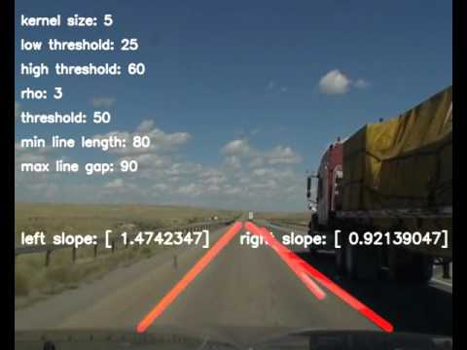

Slide 10
Within 20 years:-
One good thing about computer vision is; when it is paired with machine learning it has limitless application in various diverse fields, right from medical to military. So, simply put computer vision and especially machine learning are still in it’s elementary and budding stage and there’s a lot to come ahead.

Slide 11
Python libraries:-
1:NumPy
2:SciPy
3:matplotlib
4:PIL and pillow
5:OpenCV
6:SimpleCV
7:Mohatos
8:Scikit-learn
9:ilastik

Slide 12


